Slide 1

DNS ANOMOLY DETECTION

Slide 2
Who we are:
1- Youssef Saeed Thabet 2205064
2- Basel Yasser 2205015
3- Mohamed Ramadan 2205043

Slide 3
About The Data We got:
1- We get the data by synthetic way .
2- The data contains 15 Features and the 10000 rows.
3- The Data Features are:
Query Volume: Number of DNS queries per time unit.
Query Rate: Rate of DNS queries per time unit.
Query Type: Type of DNS query (A, AAAA, MX, etc.).
Query Domain: Domain name being queried.
Response Time: Time taken to receive a response to a query.
TTL Value: Time-to-live value in the DNS response.

Slide 4
About The Data We got (Con’t):
Source IP Address: IP address of the client making the query.
Destination IP Address: IP address of the DNS server.
Transaction ID: Unique identifier for each DNS transaction.
Query Size: Size of the DNS query in bytes.
Response Size: Size of the DNS response in bytes.
Entropy of Transaction ID: A measure of randomness in the transaction ID.
Frequency of Query Domain: How often the domain is queried.
Geolocation of Source IP: Geographic location of the client.
Anomaly Label: A binary label indicating whether the record is anomalous (1) or normal (0)

Slide 5
Brief Summary of Code :
1- First Importing the basic libraries for Preprocessing and Machine Learning model and printing the first 10 rows :
import pandas as pd
from sklearn.preprocessing import LabelEncoder
from sklearn.model_selection import train_test_split
from sklearn.ensemble import RandomForestClassifier, GradientBoostingClassifier
from sklearn.linear_model import LogisticRegression
from sklearn.metrics import accuracy_score, classification_report, confusion_matrix
from imblearn.over_sampling import SMOTE
import matplotlib.pyplot as plt
import seaborn as sns
from sklearn.metrics import accuracy_score, classification_report, confusion_matrix
import warnings
warnings.filterwarnings("ignore")
df = pd.read_csv('synthetic_dns_traffic_data.csv')
df.head()
2- displaying the first 10 rows in the data like that :

Slide 6
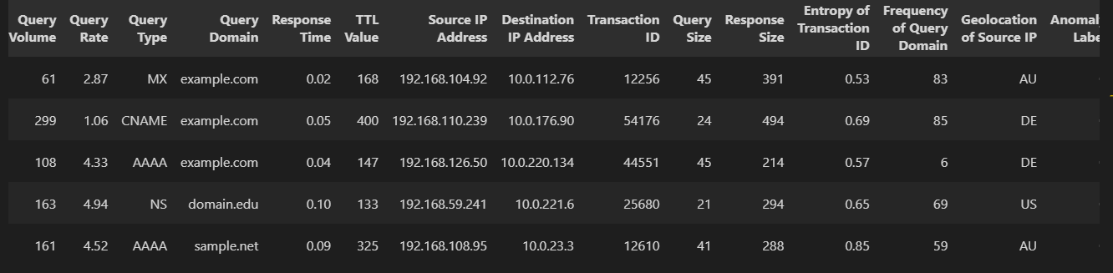
Brief Summary of Code :
3- After that we doing the class distribution of the data as anomaly and not anomly :
import seaborn as sns
import matplotlib.pyplot as plt
colors = ["#0101DF", "#DF0101"]
sns.countplot(x='Anomaly Label', data=df, palette=colors)
plt.title('Class Distributions \n (0: Normal || 1: Anomaly)', fontsize=10)

Slide 7
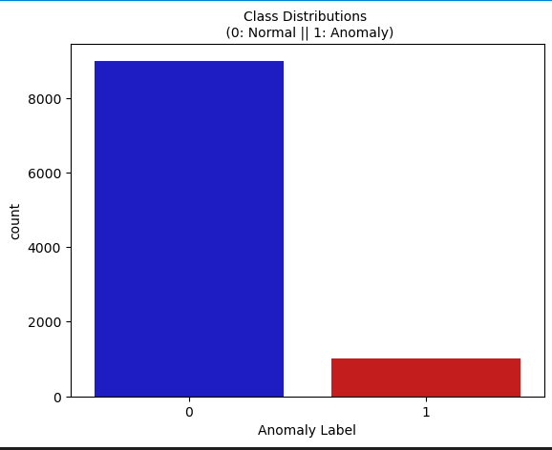
Brief Summary of Code :

Slide 8
Brief Summary of Code :
4- After That we doing the data transformation for each feature:
df.dtypes
5- After That we encoding categorical features (objects):
from sklearn.preprocessing import LabelEncoder
label_encoder = LabelEncoder()
df['Query Type'] = label_encoder.fit_transform(df['Query Type'])
df['Query Domain'] = label_encoder.fit_transform(df['Query Domain'])
df['Source IP Address'] = label_encoder.fit_transform(df['Source IP Address'])
df['Destination IP Address'] = label_encoder.fit_transform(df['Destination IP Address'])
df['Geolocation of Source IP'] = label_encoder.fit_transform(df['Geolocation of Source IP'])
df.head()
6- After That we split the features and the target class (Anonomly label)

Slide 9
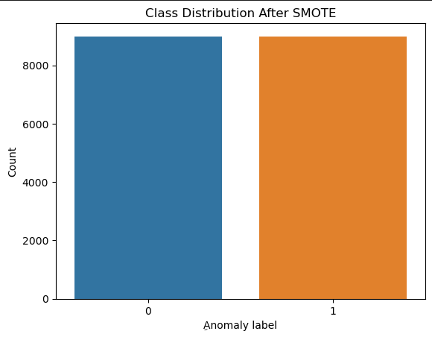
Brief Summary of Code :
features = df.drop(columns=['Timestamp', 'Anomaly Label'])
target = df['Anomaly Label']
7- After that we doing Data Balancing to balance The data using SMOTE library:
from imblearn.over_sampling import SMOTE smote = SMOTE(random_state=42)
X_resampled, y_resampled = smote.fit_resample(features, target)

Slide 10
Brief Summary of Code :
features = df.drop(columns=['Timestamp', 'Anomaly Label'])
target = df['Anomaly Label']
7- After that we doing Data Balancing to balance The data using SMOTE library:
from imblearn.over_sampling import SMOTE smote = SMOTE(random_state=42)
X_resampled, y_resampled = smote.fit_resample(features, target)
8- After that we doing Data splitting for testing 20% and Training for 80%:
X_train, X_test, y_train, y_test = train_test_split(X_resampled, y_resampled, test_size=0.2, random_state=42)
9- After that we tarin 3 models first, RandomForestClassifier Second, GradientBoostingClassifier Third, LogisticRegression
9- After that we get the confusion Matrix for each model like that:

Slide 11
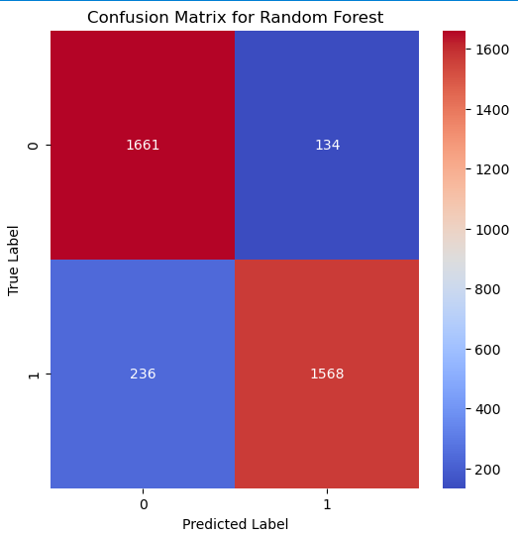
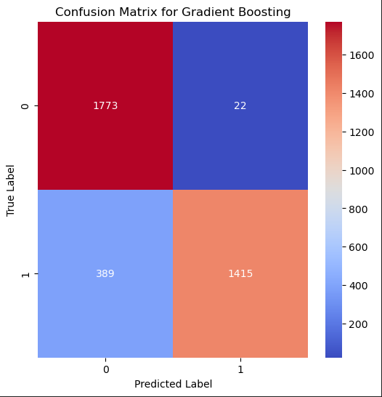
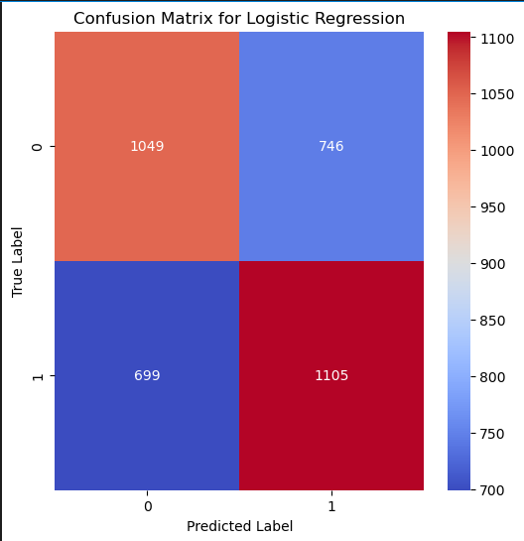
Brief Summary of Code :

Slide 12
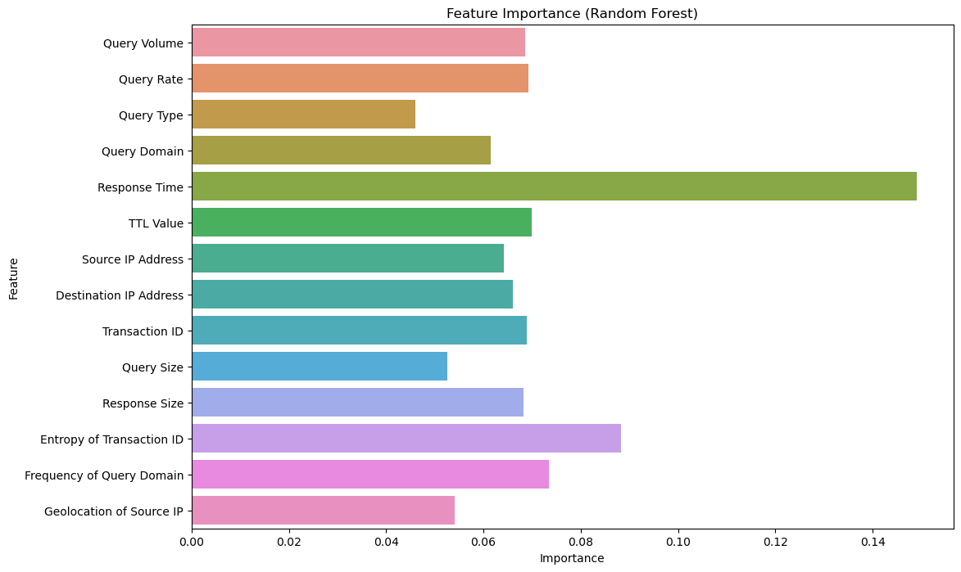
Brief Summary of Code :

Slide 13
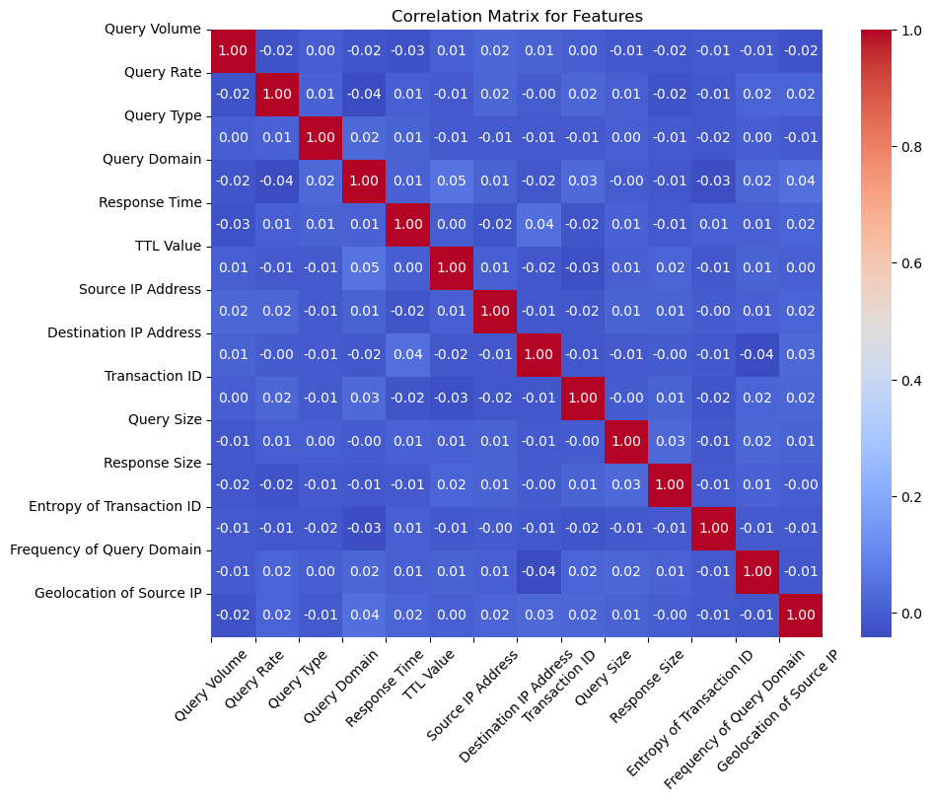
Brief Summary of Code :
Correlation matrix for all features :

Slide 14

In this project we concentrate on features all columns except the timestamp and the target (Anomaly label) and the target is the Anomaly label
The best model that has the higher accuracy is the Random Forest algorithm with 90% accuracy after that the Gradient Boosting after that the Logistic Regression

Slide 15

Thank You !
DR : Mohamed Mostafa

